Slide 1
Classes, variables, scope and packages

Slide 2
The BankAccount Example
BankAccount
balance : double
interestRate : double
interest : double
+BankAccount(startBalance:double,
intRate :double):
+ deposit(amount : double) : void
+ withdrawl(amount : double: void
+ addInterest() : void
+ getBalance() : double
+ getInterest() : double

Slide 3
Classes, Variables and Scope
The list below shows the scope of a variable depending on where it is declared.
Inside a method:
Visible only within that method.
Called a local variable.
In a method parameter: ( public void setLength(int len))
Called a parameter variable. (len)
Same as a local variable
Visible only within that method.
Inside the class but not in a method:
Visible to all methods of the class.
Called an instance field.

Slide 4
Shadowing
A parameter variable is, in effect, a local variable.
Within a method, variable names must be unique.
A method may have a local variable with the same name as an instance field.
This is called shadowing.
The local variable will hide the value of the instance field.
Shadowing is discouraged and local variable names should not be the same as instance field names.

Slide 5
public class Rectangle{
private int length;
private int width;
...........................
public void setLength(int length)// length variable shadows length variable of class
{
length=length // ambiguous statement. Instead use this.length = length;
}
}

Slide 6
Packages and import Statements
A package is a group of related classes.
The classes in the Java API are organized into packages.
For example, the Scanner class is in the java.util package.
Many of the API classes must be imported before they can be used. For example, the following statement is required to import the Scanner class:
import java.util.Scanner;
This statement appears at the top of the program's source code.

Slide 7
Packages and import Statements
Explicit import Statements
An explicit import statement specifies a single class: import java.util.Scanner;
Wildcard import Statements
A wildcard import statement imports all of the classes in a package: import java.util.*;

Slide 8
Packages and import Statements
The java.lang package
Automatically imported into every Java program.
Contains general classes such as String and System.
You do not have to write an import statement for the java.lang package.

Slide 9
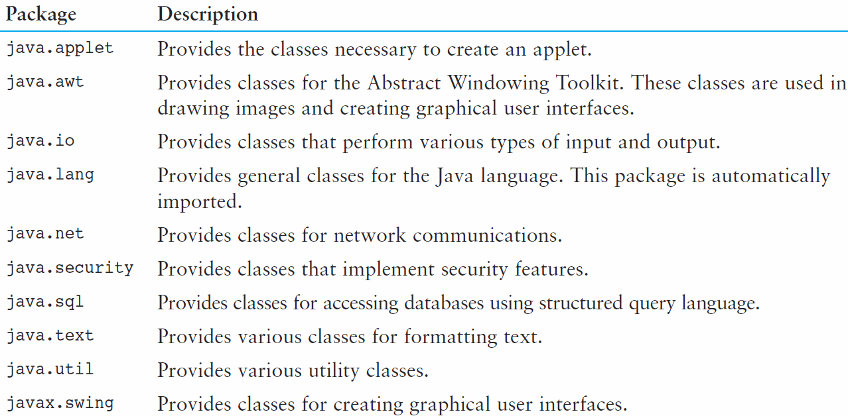
Packages and import Statements
You will use other packages as you learn more about Java.
Table 3-2 lists a few examples.

Slide 10
Object Oriented Design Finding Classes and Their Responsibilities
Finding the classes
Get written description of the problem domain
Identify all nouns, each is a potential class
Refine list to include only classes relevant to the problem
Identify the responsibilities
Things a class is responsible for knowing
Things a class is responsible for doing
Refine list to include only classes relevant to the problem

Slide 11
Object Oriented Design Finding Classes and Their Responsibilities
Identify the responsibilities
Things a class is responsible for knowing
Things a class is responsible for doing
Refine list to include only classes relevant
to the problem

Slide 12
END

